Slide 1
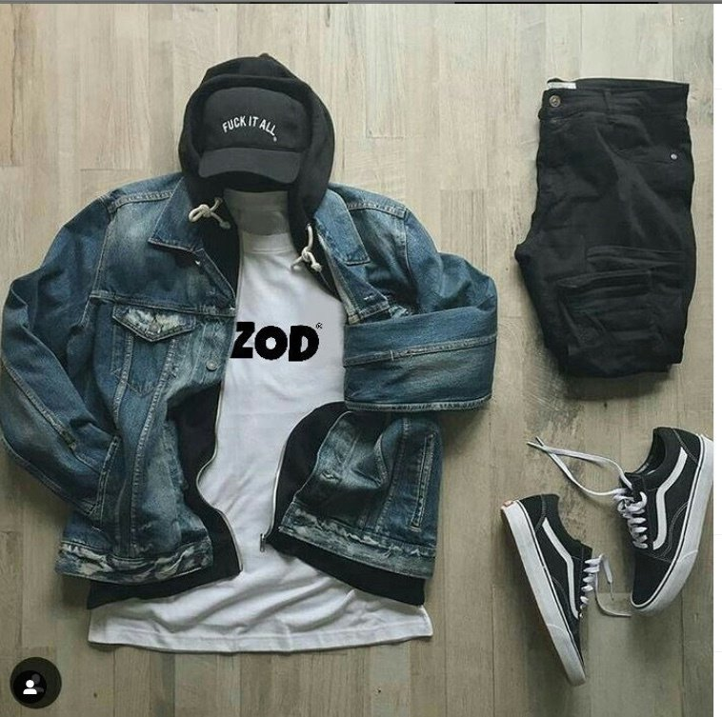
Which area would be most susceptible to extend Dezod_brand?
DEZOD_BRAND

Slide 2

PROJECT DESCRIPTION
Dezod_brand is a collection of clothes such as: t-shirts, pants, hats etc. Dezodbrand wants to conquer other international markets so they decided to put the brand in toronto. The marketing team needs to do a field study in the Toronto area to see which city of Toronto would be best for us to launch the brand.
Part 1:
Project Description

Slide 3



Table of Methodology
Part 1:
Part 4:
Problem statement
Visualization
Part 2:
Part 5:
Data Collection
Summary
Part 3:
Part 6:
Data Preprocessing
Result

Slide 4

AUDIENCE
The management team needs to do a site study to see which is the best place in Toronto that will be best to install it. and everyone who needs to analyze an area either for a product, a service or to install a service.

Slide 5

HOW DO WE ARE GOIN TO START
we will categorize areas with similar characteristics with an algorithm

Slide 6
After data processing
we have
28
Selected Features
After that we apply the Kmeans Clustering Algorithm to do the clustering and we apply formulas that can let us see which areas will be best for us to extend the brand through scores.
.
Part 5:
Selected features

Slide 7
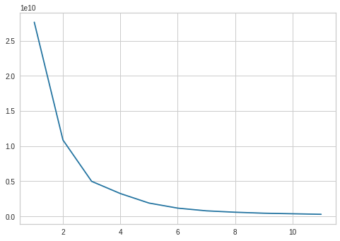
Through the Elbow Clustering chart, we see that we can group our data into three clusters

Slide 8
INDICES OF CONSTRUCTIONS SCORE'S
Population Age
Index of Security
Caribbean Immigrants
Business group
indice of Scores
Implementing a more integrated system to help us achieve our goals

Slide 9
City of Toronto
Access areas likely to place the Brand after scores
Capitalize on areas with the scores we have found
The best area where we can Extend the brand for success
Mount olive silverstone-jamestown
west hil
Malvern
Scarborough village
waterfront communities-the island
2.388985
2.281039
2.445660
2.266917
2.103456

Slide 10
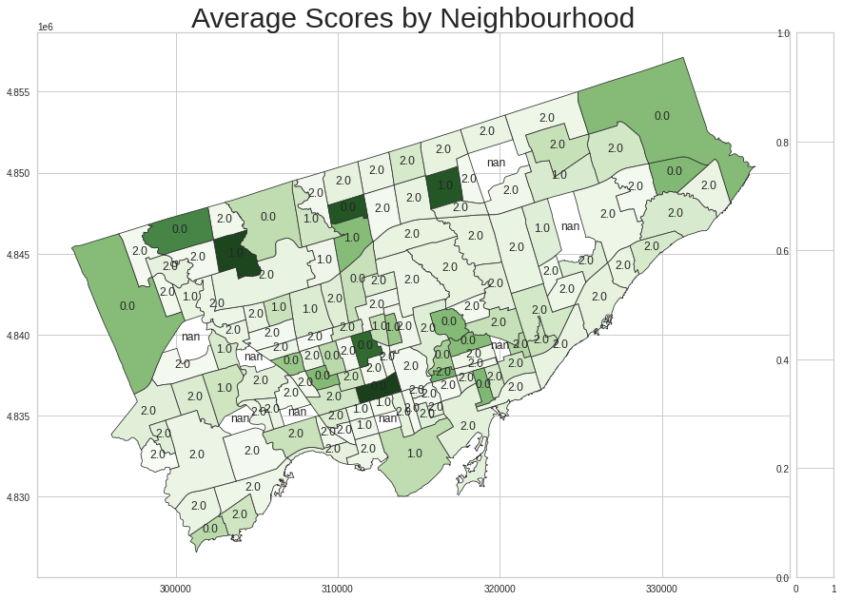
Through this map we show the scores of the highest areas

Slide 11
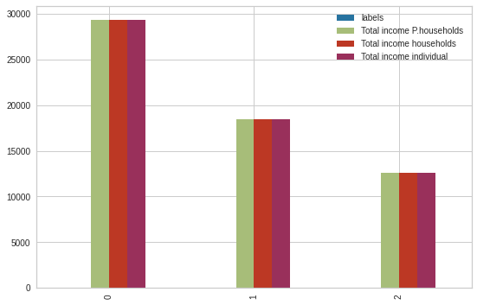
The average Income group
Here the chart that show us the average of
the income's population , we can see the
best rate is the First Cluster.

Slide 12
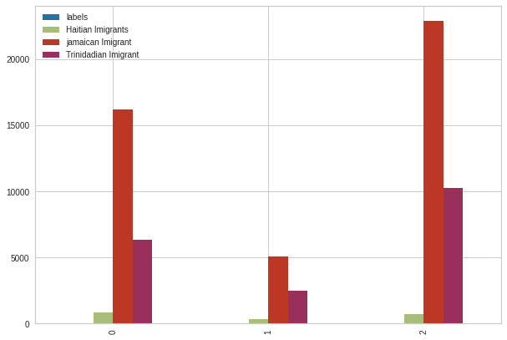
Imigrants's Caribbean group
Here the chart that show us the sum of the venues of
the population ,through out our chart we can see that the
cluster 2 has the best rate .

Slide 13
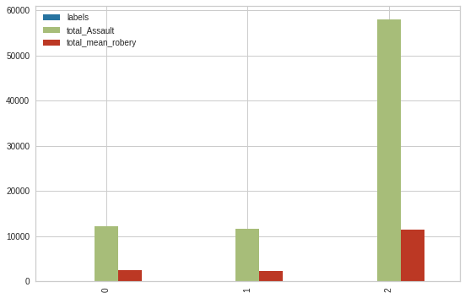
Security index group
Here the chart that show us the Total assault & robery of the population, the ratio of assault is 10778.800971 and the robbery ratio is 1955.913922 so the cluster 2 has
the best rate

Slide 14
OUR RECOMMENDATIONS AND CONCLUSIONS
we are supposed to select the first three cities because through our study, we find that they have the best score
Create a marketing campaign that will make people in the area know about the brand
I encourage you to extend the brand into North America and do the same field study to see where we can best place it.
Part 10:
recommendations

Slide 15

Neighbourhoods crime rates
https://data.torontopolice.on.ca/datasets/neighbourhood-crime-rates-2020-1/explore?showTable=true
Shooting and Firearm Discharges
https://data.torontopolice.on.ca/datasets/shootings-and-firearm-discharges/explore?showTable=true
REFERENCE & APENDICES
Profile dataset
https://www.toronto.ca/city-government/data-research-maps/neighbourhoods-communities/neighbourhood-profiles/
https://github.com/engy06/Capstone_pp.git

Slide 16
Matteucci Cyril
Thank you!

